Slide 1
Virtual Portfolio
Frankie Gilmore, Stylist & Personal Shopper

Slide 2
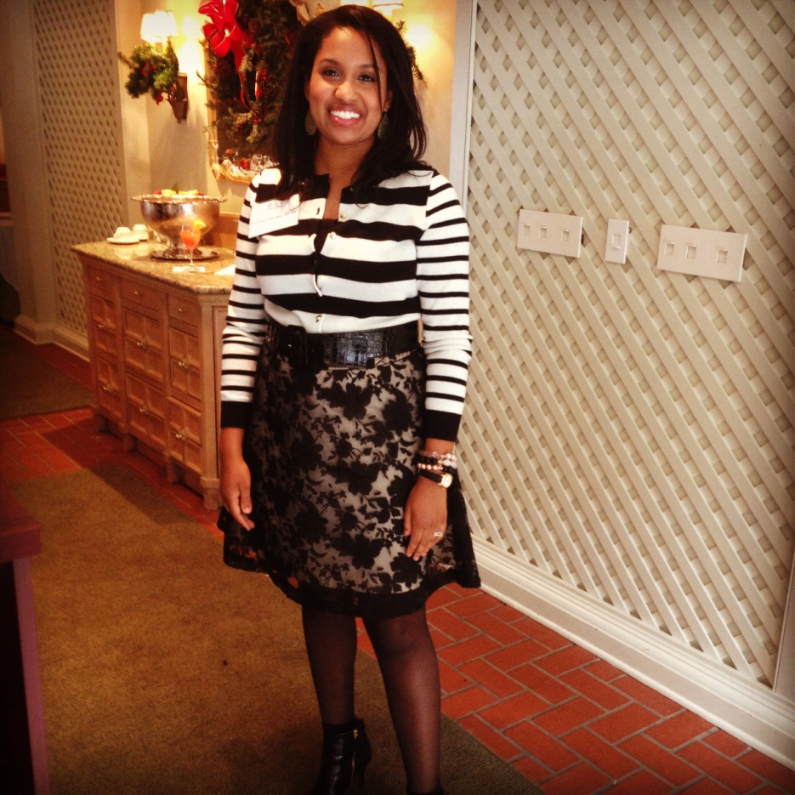
About Me
Who I Am, What I Do
  Stylist & Personal Shopper
  Started styling in 2009
  Started Gilmore Style Consulting in 2010
  My Vision – To bring out the beauty in women through fabulous style.
  Clientele – Women of all ages and walks of life

Slide 3
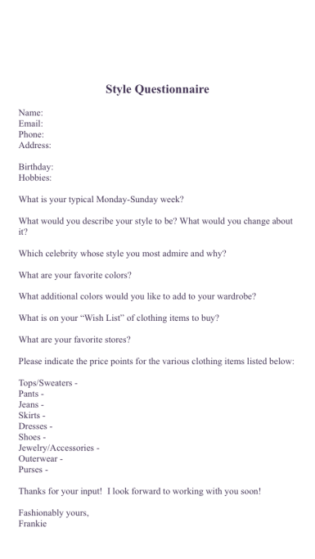
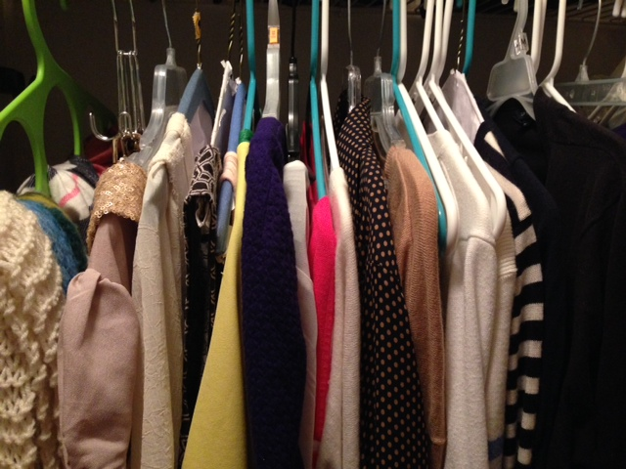
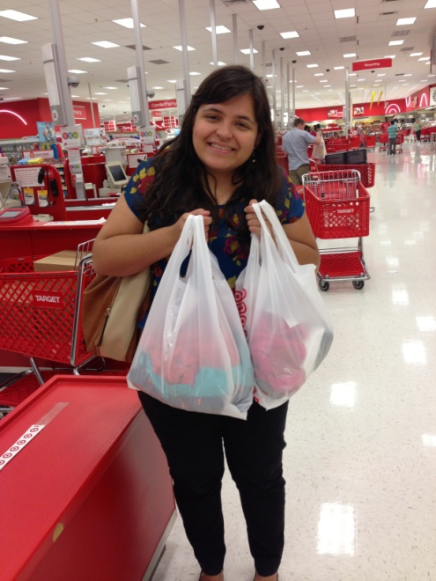
3-Phase Style Process
Style Assessment – Discovering your personal style
Wardrobe Edit – “Reduce, reuse, or recycle” pieces in your closet
Personal Shopping – Refreshing your wardrobe with a style-specific shopping plan

Slide 4
Event Experience

Slide 5

Tri-Umph! Event
In August of 2013, I hosted a networking event with a wellness coach and a skin care consultant.
The program focused on educating women on wellness, skincare, and style.
The event took place at the Saltworks Gallery in Atlanta’s Westside Provisions District.

Slide 6
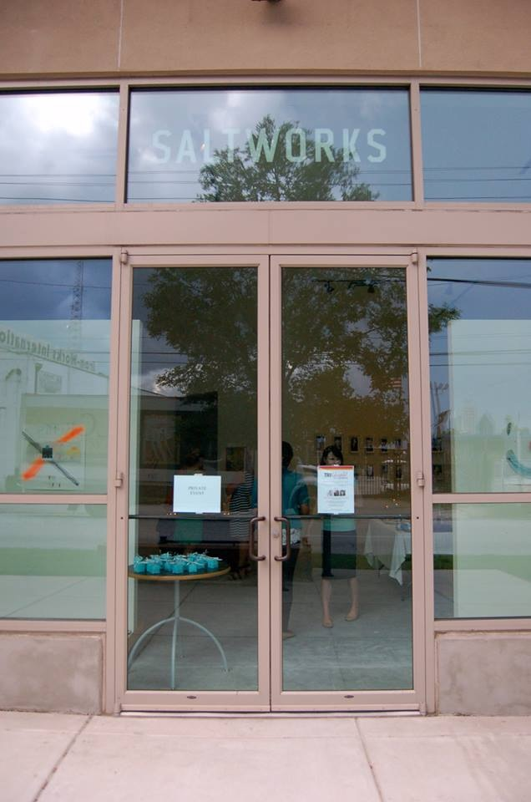
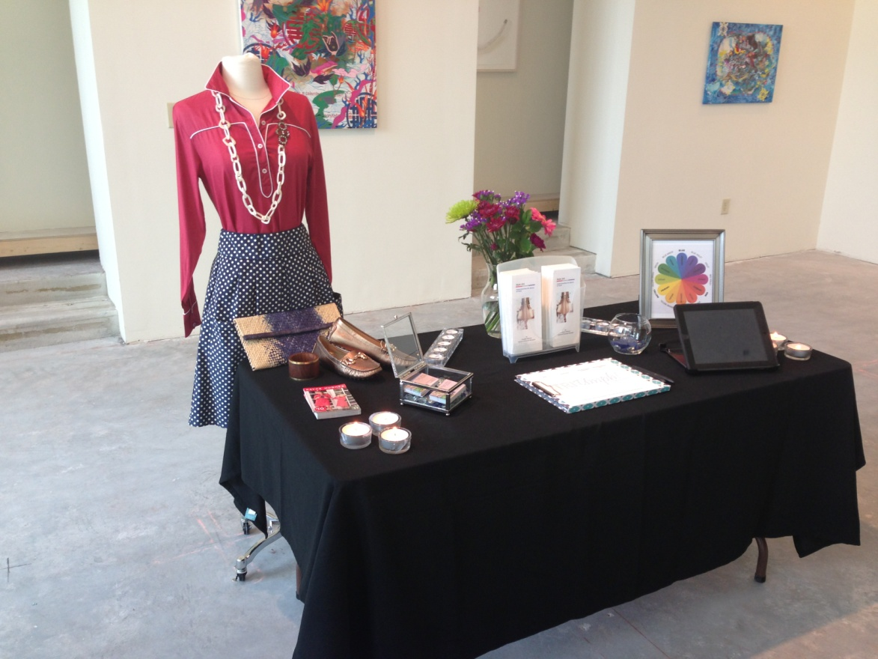
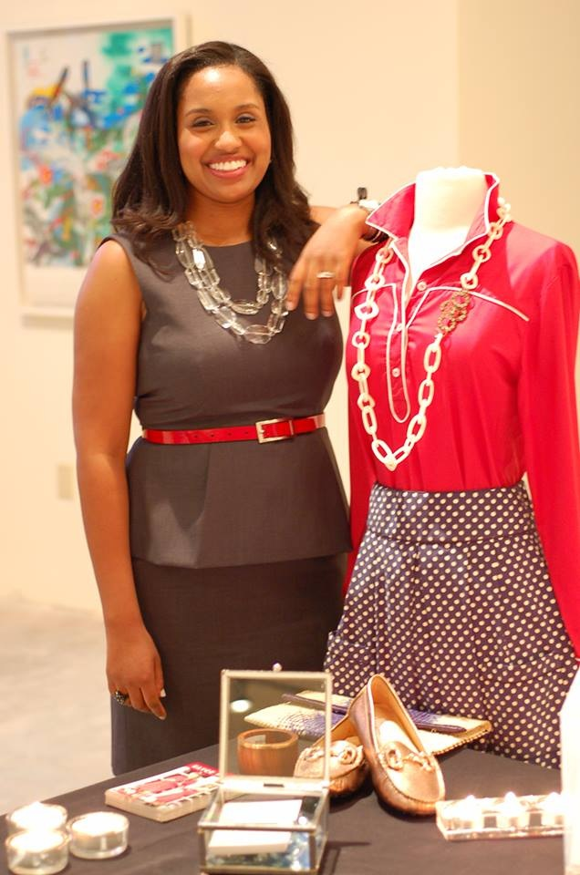
Tri-Umph! Event

Slide 7
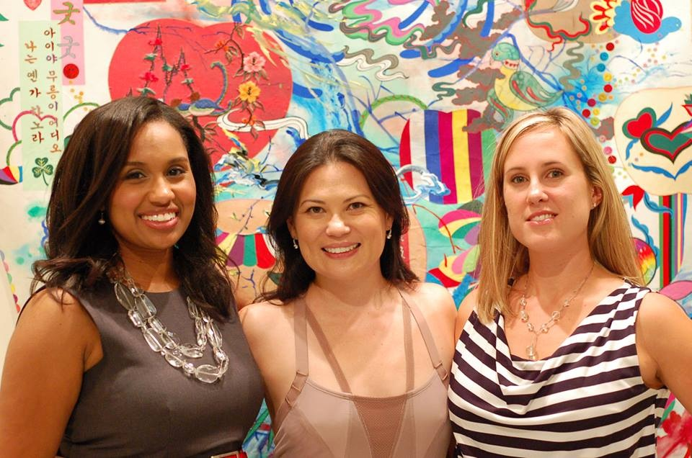
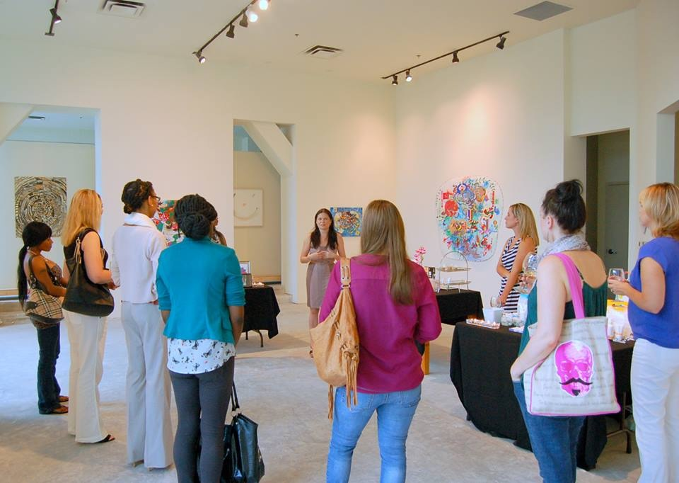
Tri-Umph! Event

Slide 8
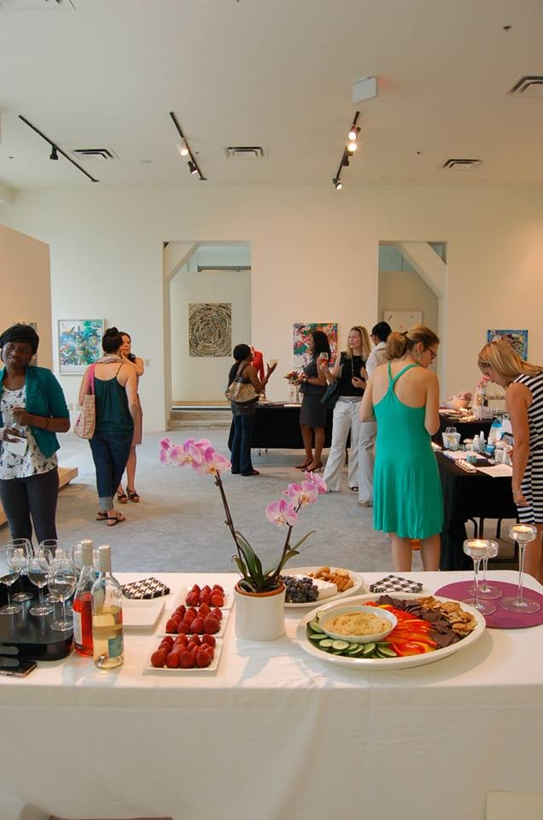

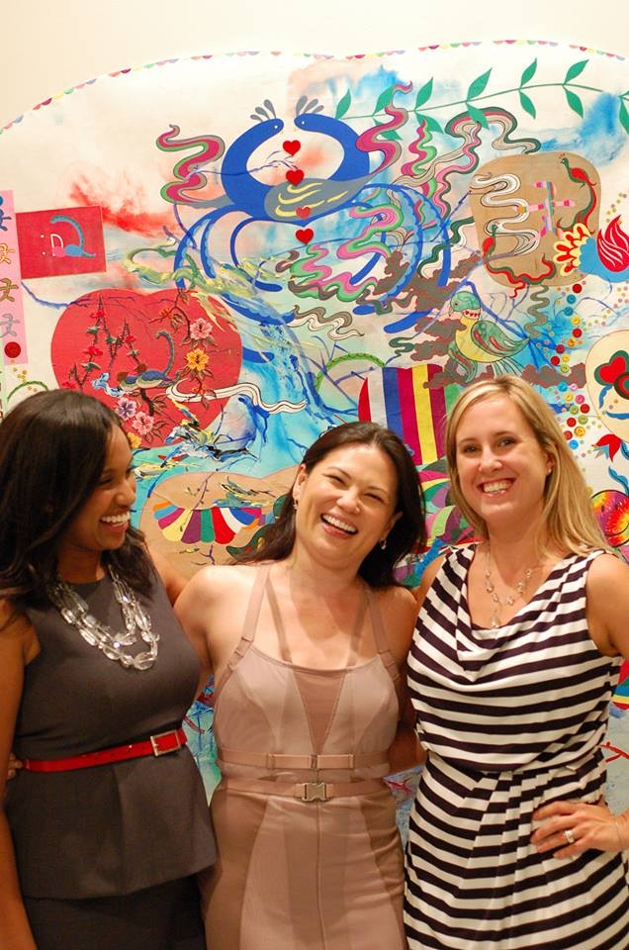
Tri-Umph! Event

Slide 9
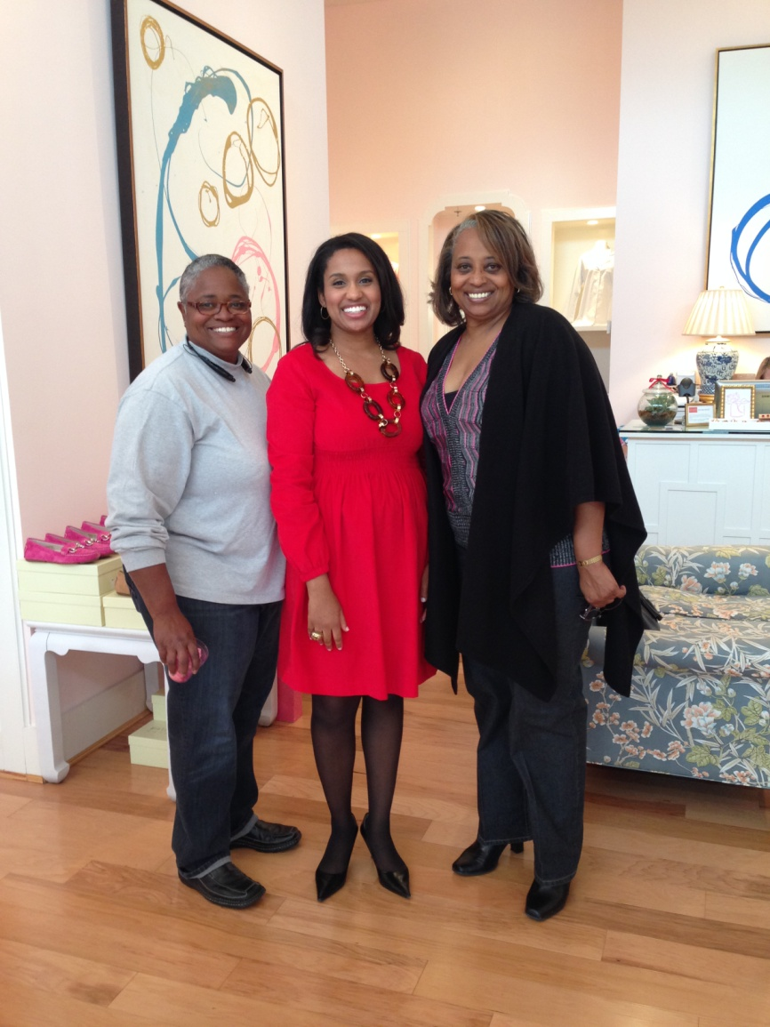
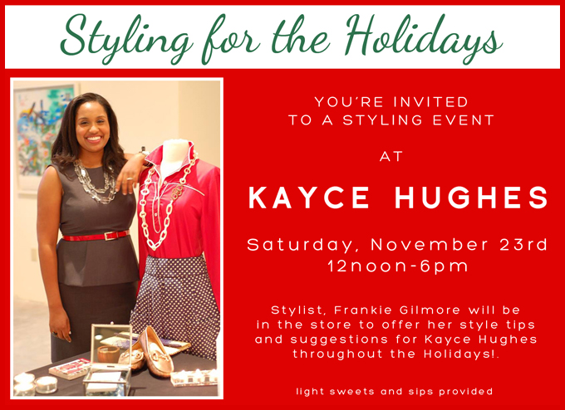
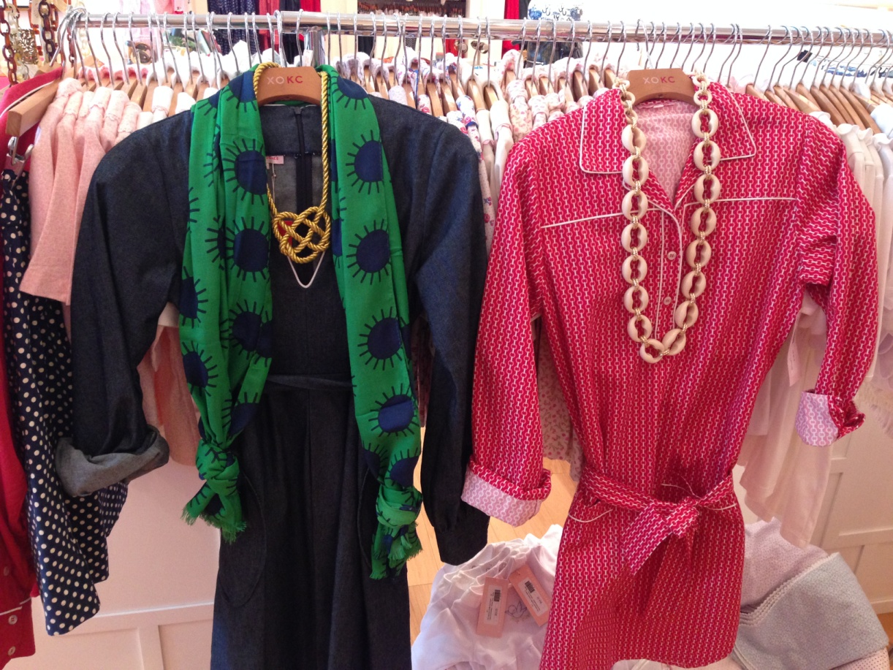
Kayce Hughes Event
In November of 2013, I hosted a special style event at Kayce Hughes, also in Atlanta’s Westside Provisions District.

Slide 10
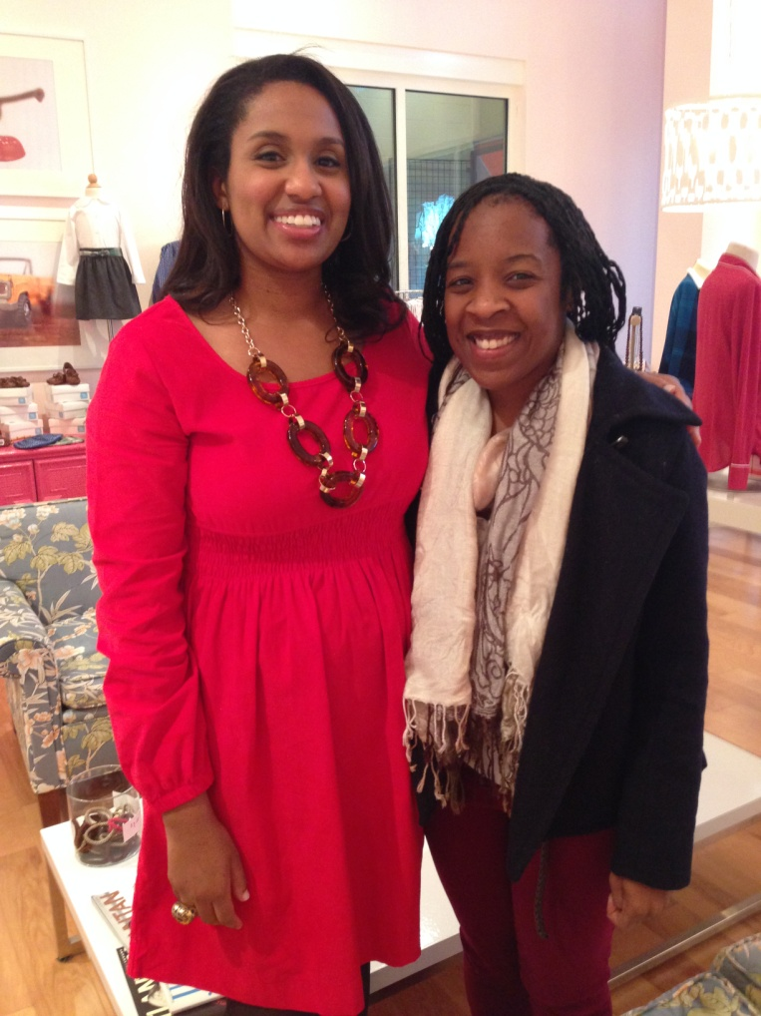
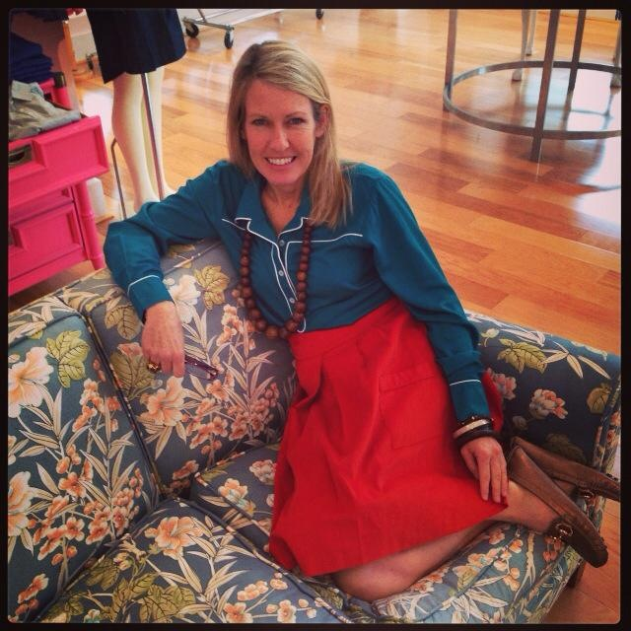
Kayce Hughes Event

Slide 11
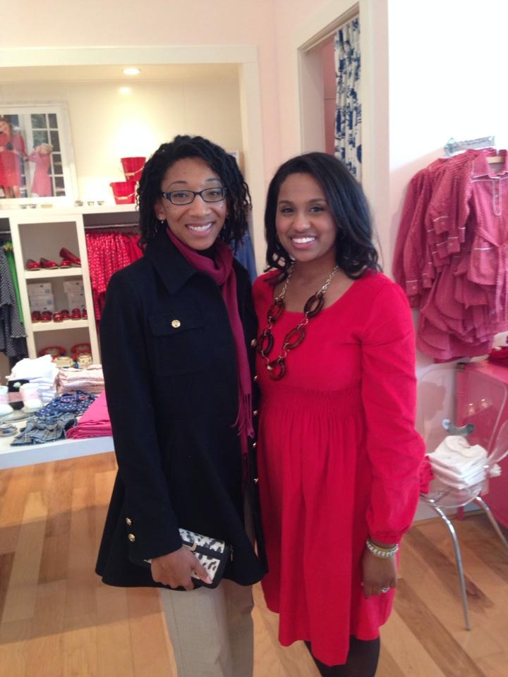
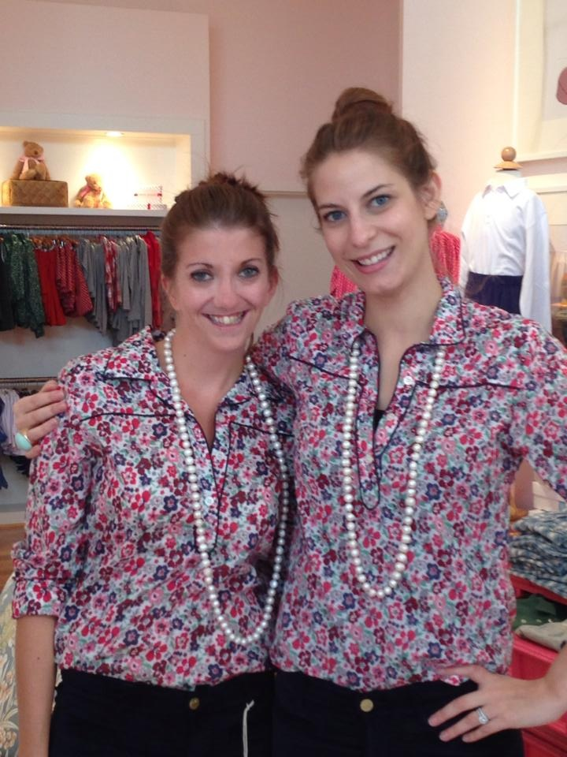
Kayce Hughes Event

Slide 12
My Clients

Slide 13
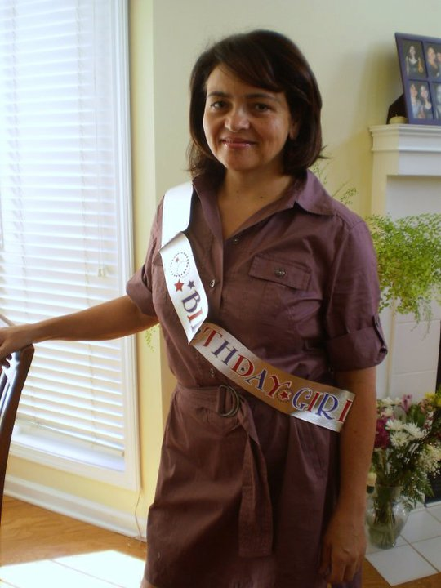
Luzia M. (Before)

Slide 14
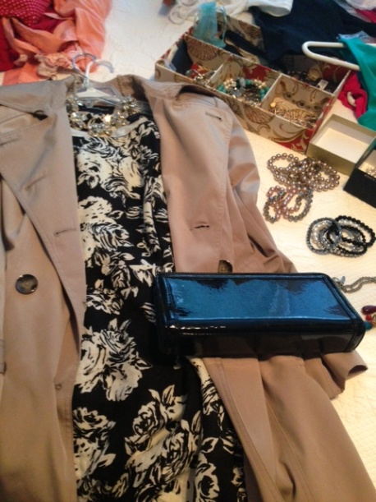
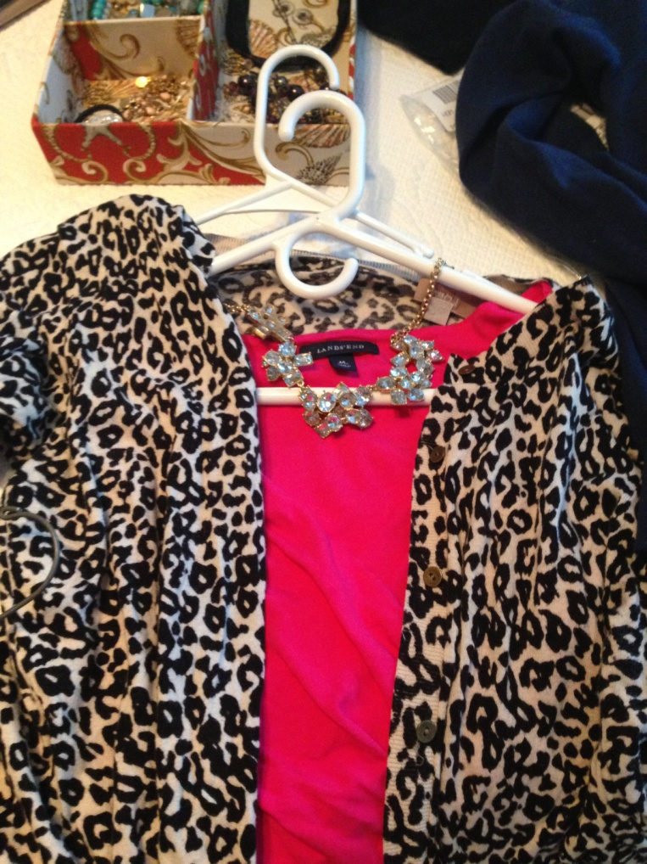
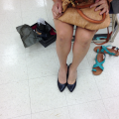
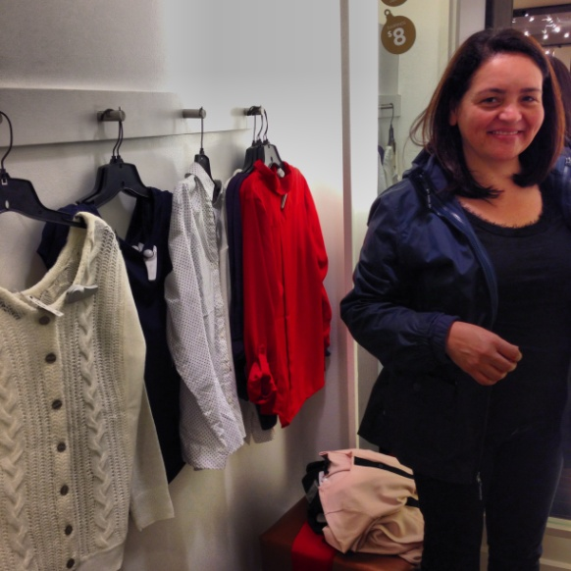
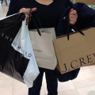
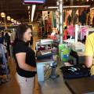
Wardrobe Editing & Shopping with Luzia

Slide 15
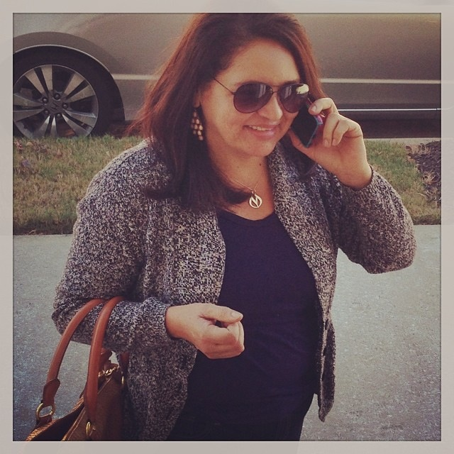
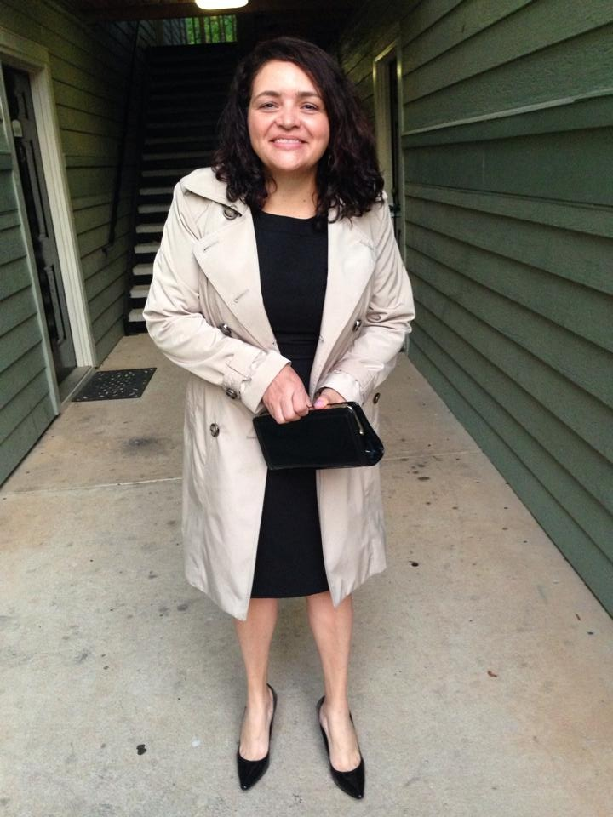
Luzia M. (After)

Slide 16
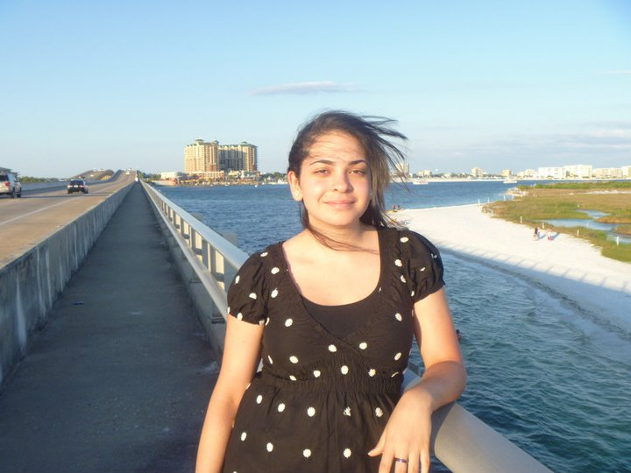
Mara M. (Before)

Slide 17
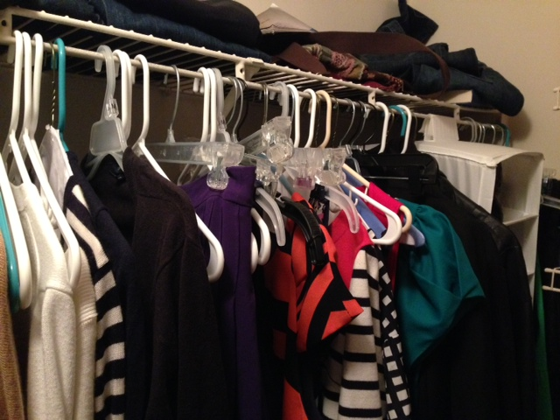
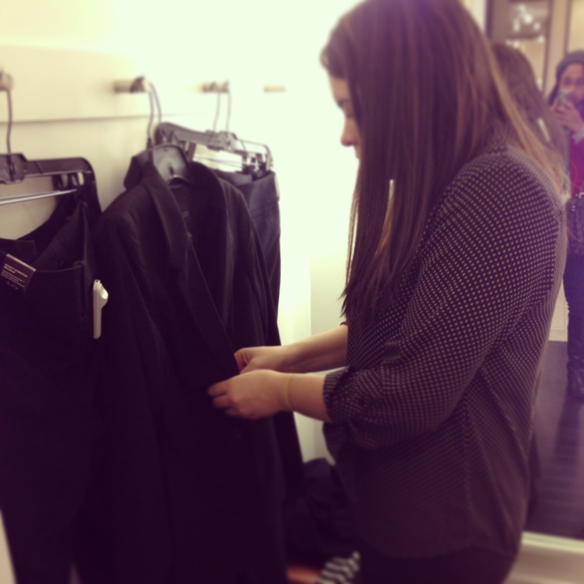
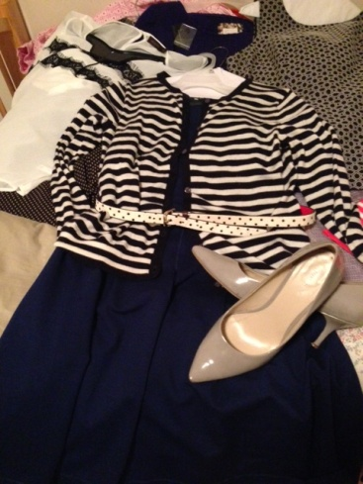
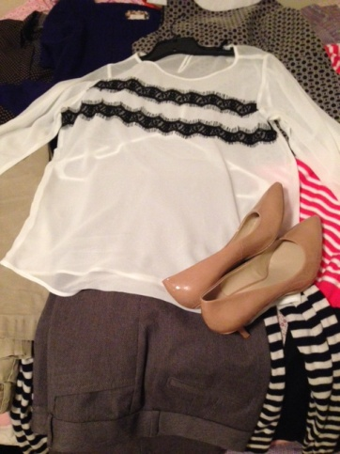
Wardrobe Editing & Shopping with Mara

Slide 18
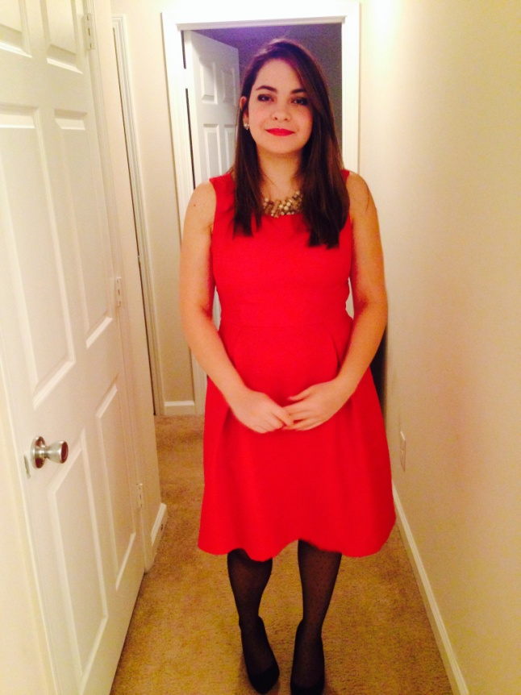
Mara M. (After)

Slide 19
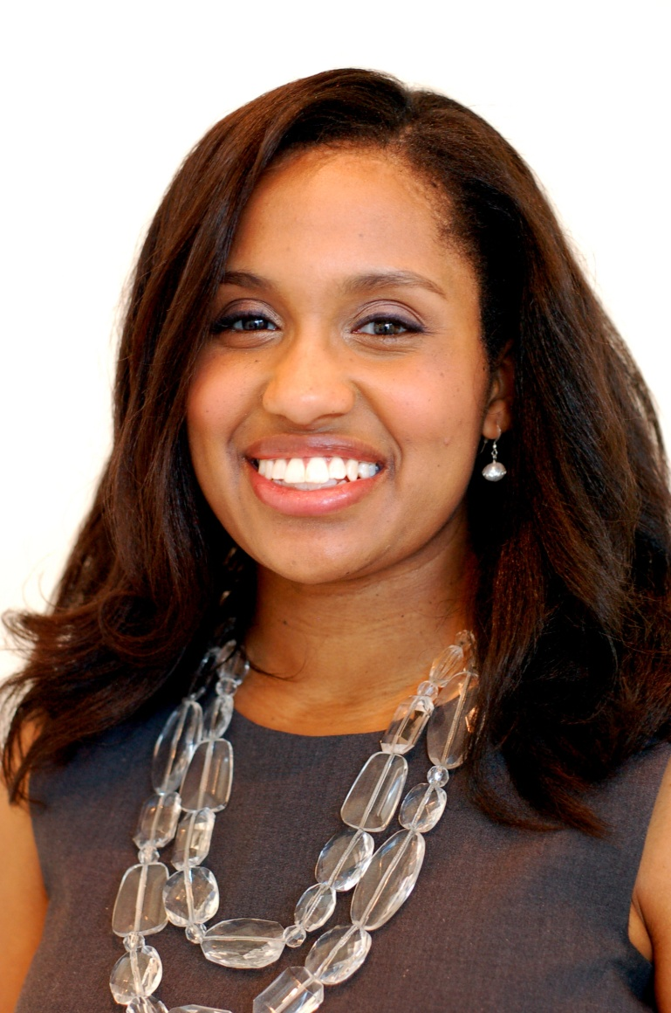
Calling Card
Frankie Gilmore, Stylist & Personal Shopper
  Gilmore Style Consulting
Contact Me
  Phone: 404-216-4555
  Email: fwg475@hotmail.com
Follow Me
  Instagram: frankiestyle101
  Website: www.facebook.com/frankiegilmorestyle

